Slide 1

MARKET ANAYSIS
CDACL-06-Market Analysis
Submitted By : Deepak R Rayabagkar
Course: CDA Internship
Tools Used: SQL, Power BI, Power Query, DAX

Slide 2
Project Overview
The Market Analysis project focuses on analyzing customer purchasing behavior, product performance, and ordering patterns using an online retail dataset. The project integrates multiple datasets, including orders, products, aisles, departments, and prior order details, to uncover meaningful business insights. By performing data cleaning, transformation, aggregation, and visualization, the analysis helps identify customer preferences, reorder behavior, peak shopping periods, and product demand. These insights support data-driven decision-making to optimize marketing strategies, inventory management, and overall customer satisfaction.

Slide 3
Database Overview(project_orders)
Dataset | Description
Orders | Contains customer order details such as user ID, order sequence, day of the week, hour of order, and days since the previous order.
Order Products train | Records the products included in each order, their cart position, and whether they were reordered.
Products | Contains product names along with their corresponding aisle and department IDs.
Aisles | Lists aisle IDs and aisle names.
Departments | Lists department IDs and department names.
Dataset Overview
The project uses five related datasets:
The datasets are linked using primary keys such as order_id, product_id, aisle_id, and department_id to perform comprehensive analysis across multiple tables.

Slide 4
Project Objectives
Analyze customer purchasing behavior and shopping patterns.
Identify the top-selling and most reordered products.
Evaluate product distribution across aisles and departments.
Analyze order volume by day of the week and hour of the day.
Study customer reorder behavior and average time between orders.
Measure average order size and products added per cart.
Identify the most active users and frequently purchased products.
Generate business insights that help optimize marketing strategies, inventory planning, and customer satisfaction

Slide 5
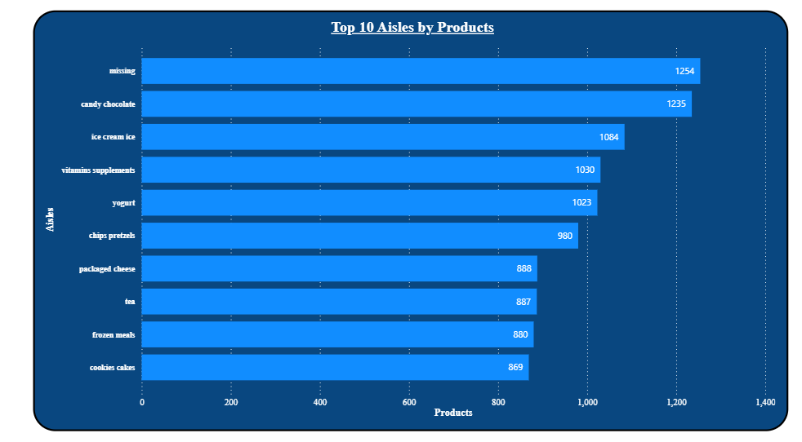
Top 10 Aisles by Products
INSIGHTS:
The 'missing' aisle contains the highest number of products (1,254), indicating that a significant number of products are not assigned to a specific aisle and may require data quality improvements.
Candy Chocolate (1,235) and Ice Cream Ice (1,084) are among the largest aisles, showing that snack and frozen dessert categories have a wide product variety.
Vitamins & Supplements (1,030) and Yogurt (1,023) also contain a large number of products, reflecting strong product diversity in health and dairy categories.
The difference between the highest-ranked aisle (1,254 products) and the tenth-ranked aisle (869 products) is relatively small, indicating a balanced distribution among the top aisles.
Most of the top aisles are related to daily consumer goods, suggesting that the retailer focuses heavily on frequently purchased grocery items.

Slide 6
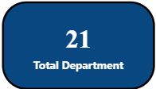
Unique Departments
INSIGHTS
The dataset consists of 21 departments, representing a wide range of product categories.
These departments provide a structured hierarchy that helps organize products efficiently for inventory management and reporting.
The relatively small number of departments simplifies category-level analysis while still covering diverse product segments.

Slide 7
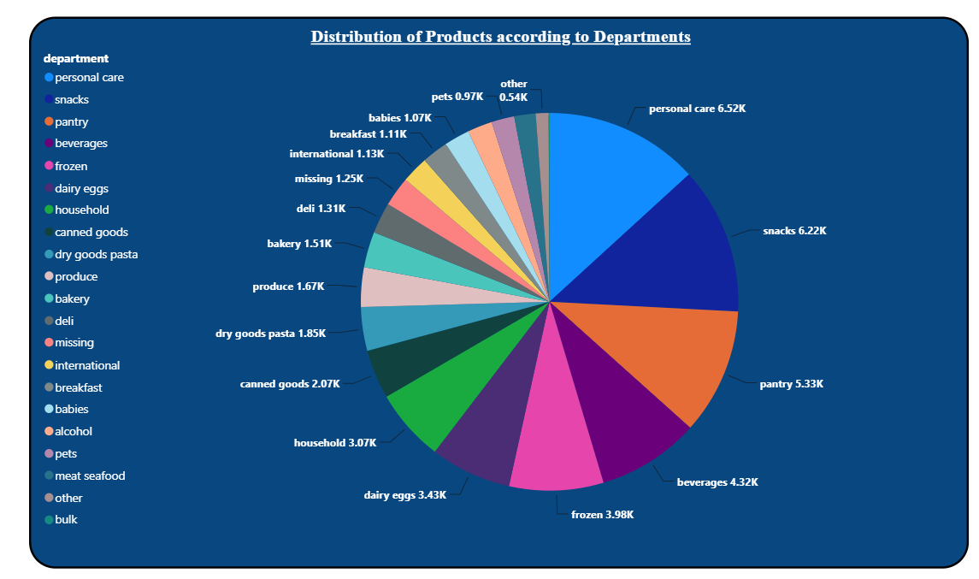
Distribution of Products across Departments
INSIGHTS:
Personal Care (6.52K products) is the largest department, accounting for the highest share of products in the catalog.
Snacks (6.22K) and Pantry (5.33K) are the next largest departments, indicating extensive product variety in everyday grocery categories.
Beverages (4.32K) and Frozen (3.98K) also contribute significantly, highlighting strong representation of convenience and ready-to-consume products.
Departments such as Bulk, Other, and Meat Seafood contain comparatively fewer products, suggesting a more specialized or limited product assortment.
The product distribution is uneven across departments, with a few major departments contributing a substantial portion of the overall product catalog.

Slide 8
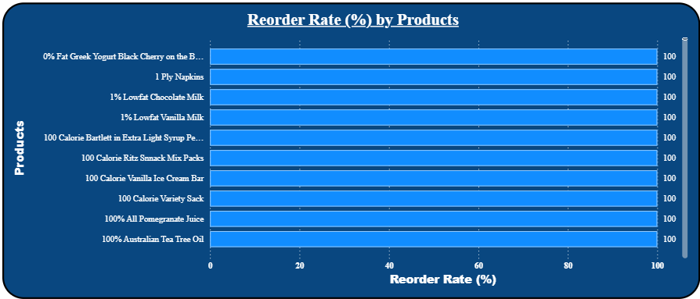
Distribution Reorder Rate by Products
INSIGHTS
All displayed products have a 100% reorder rate, indicating exceptionally high customer loyalty.
These products are consistently repurchased, suggesting they are essential or frequently consumed items.
The products have strong customer retention and stable demand.
Maintaining adequate inventory for these products is critical to avoid stock-outs.
These products can be prioritized for promotional bundles and cross-selling due to their proven repeat purchase behavior.

Slide 9
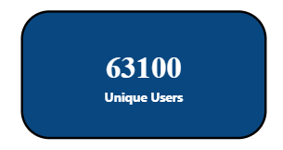
Unique Users
INSIGHTS
The business has reached 63,100 unique customers, reflecting a broad customer base.
A large customer base increases opportunities for repeat purchases and customer retention.
The data represents diverse customer purchasing behavior, making the analysis more reliable.
Even a small increase in customer retention can significantly impact overall sales and revenue.

Slide 10
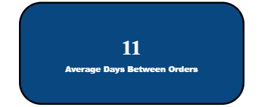
Average number of days between orders
INSIGHTS
Customers place repeat orders every 11 days on average, indicating frequent purchasing behavior.
The short reorder cycle reflects strong customer engagement and product demand.
Inventory replenishment should align with this purchase cycle to ensure product availability.
Marketing campaigns, reminders, or personalized offers can be scheduled around the 10–11 day mark to encourage repeat purchases.
The consistent purchase interval helps improve demand forecasting and inventory planning.

Slide 11
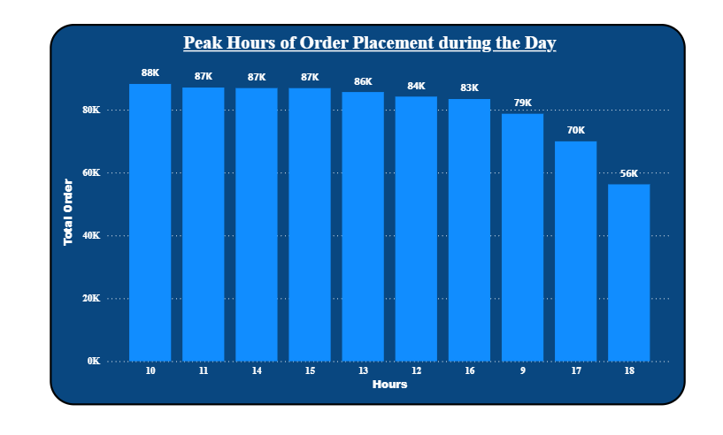
Peak Hour of Order Placement during the Day
INSIGHTS
10:00 AM is the busiest hour with approximately 88K orders, making it the peak ordering time.
Order volume remains consistently high between 10 AM and 3 PM (84K–88K orders), indicating strong customer activity during midday.
After 4 PM, order volume begins to decline, with a sharper drop after 5 PM.
6:00 PM records the lowest order volume (56K) among the displayed hours, suggesting reduced customer activity in the evening.
The business should ensure maximum inventory availability, staff allocation, and delivery capacity during the 10 AM–3 PM window.
Promotional campaigns can be scheduled during off-peak hours (after 5 PM) to improve order distribution.

Slide 12
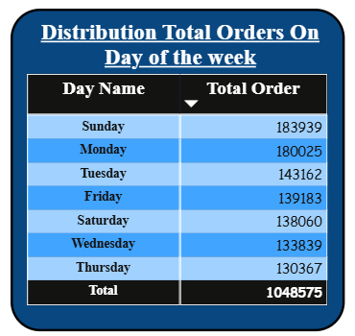
Distribution of Orders by Day of the Week
INSIGHTS
Sunday recorded the highest number of orders (183,939), making it the busiest day of the week.
Monday follows closely (180,025 orders), indicating continued high customer demand after the weekend.
Thursday has the lowest order volume (130,367) among all weekdays.
Total orders across the week amount to 1,048,575, reflecting strong overall business activity.
Weekend and the beginning of the week generate significantly higher demand than midweek.
Inventory and workforce planning should prioritize Sunday and Monday, while promotions can target Thursday and Wednesday to increase sales.

Slide 13
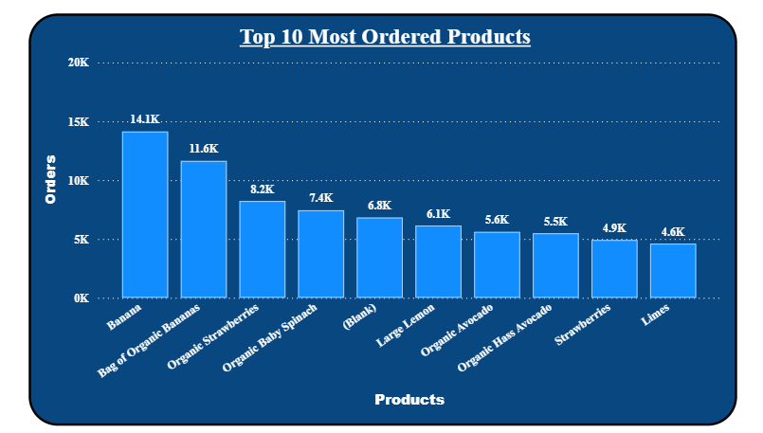
Top 10 Most ordered Products
INSIGHTS
Bananas are the most ordered product with approximately 14.1K orders, making them the highest-demand item.
Fresh produce dominates the top-selling products, including Organic Strawberries, Organic Baby Spinach, Avocados, Lemons, Strawberries, and Limes.
Bag of Organic Bananas ranks second with 11.6K orders, showing strong customer preference for both regular and organic bananas.
The demand drops gradually after the top two products, indicating that bananas contribute significantly to overall sales.
High-demand products should be prioritized for inventory management to minimize stock-outs.
These products are ideal candidates for bundling, promotional offers, and recommendation systems to increase average order value.

Slide 14
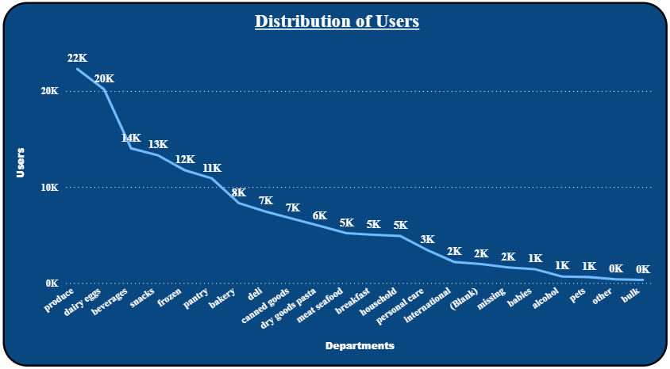
Distribution of Users by Department
INSIGHTS
Produce has the largest user base with approximately 22K users, making it the most popular department.
Dairy & Eggs (20K) and Beverages (14K) are the next most visited departments, indicating strong customer preference for everyday essentials.
User count gradually declines across other departments, with Snacks, Frozen, Pantry, and Bakery maintaining moderate engagement.
Specialty departments such as Alcohol, Pets, Other, and Bulk have the lowest user counts, reflecting niche customer demand.
The concentration of users in a few departments suggests that core grocery categories drive most customer traffic.

Slide 15
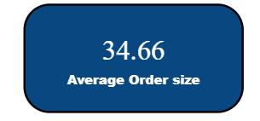
Average number of Products per Order
INSIGHTS
The average order size is 34.66 items, indicating customers typically purchase multiple products in a single order.
A relatively large basket size suggests customers prefer completing their grocery shopping in one transaction.
This reflects strong customer engagement and provides opportunities for increasing revenue through complementary product recommendations.
Maintaining stock availability for frequently purchased items is essential to support large basket purchases.
Bundling and personalized recommendations can further increase the average order size.

Slide 16
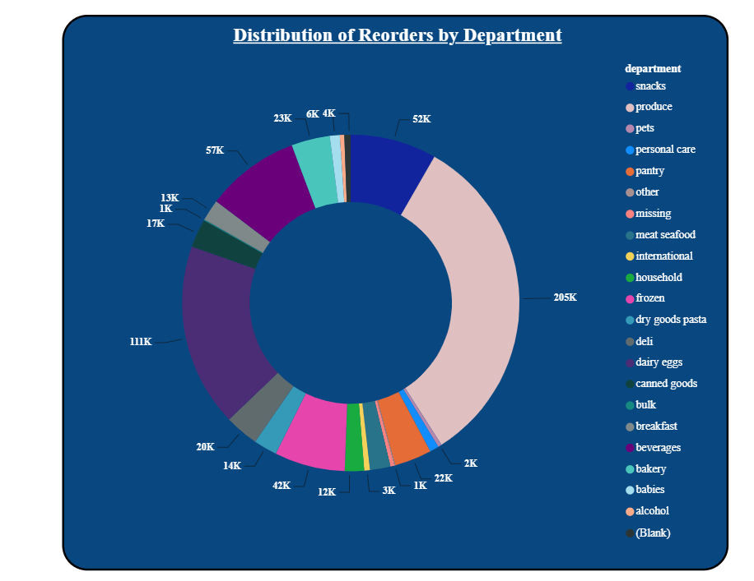
Distribution of Reordered Products by Department
INSIGHTS
Produce leads reorders with approximately 205K, demonstrating the highest customer loyalty and repeat purchasing.
Dairy & Eggs (111K) and Beverages (57K) also contribute significantly to total reorders.
Departments such as Snacks (52K) and Frozen (42K) show consistent repeat demand.
Categories like Alcohol, Pets, Personal Care, and Other contribute relatively fewer reorders, indicating lower repeat purchase frequency.
Reorder patterns are concentrated in essential grocery categories, suggesting customers frequently repurchase fresh food and daily necessities.
Inventory planning should prioritize departments with the highest reorder volumes to minimize stock-outs and improve customer satisfaction.

Slide 17
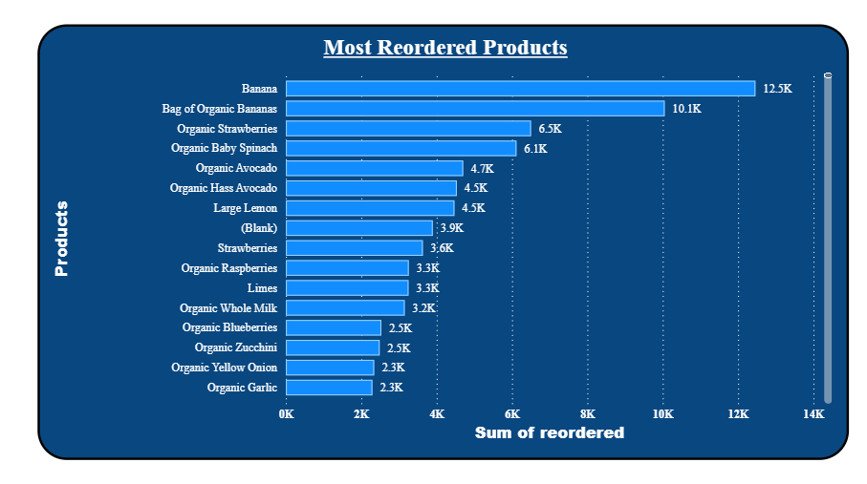
Products Reordered more than once
INSIGHTS
Bananas are the most reordered product with 12.5K reorders, indicating the highest customer loyalty.
Bag of Organic Bananas (10.1K) ranks second, showing strong demand for both regular and organic bananas.
Fresh produce dominates the list, including Organic Strawberries, Organic Baby Spinach, Avocados, Lemons, and Berries, highlighting customers' preference for fresh grocery items.
There is a noticeable drop in reorder volume after the top two products, suggesting they are the primary drivers of repeat purchases.
High reorder rates for these products emphasize the importance of maintaining sufficient inventory and minimizing stock-outs.
These products are ideal for loyalty programs, subscription services, and personalized recommendations.

Slide 18
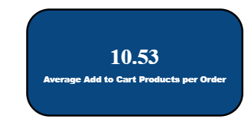
Average Add to Cart Products per Order
INSIGHTS
Customers add an average of 10.53 products per order, indicating multi-item shopping behavior.
The average suggests customers prefer purchasing several items in a single transaction rather than placing multiple small orders.
A higher cart size contributes positively to overall sales and revenue.
Cross-selling and product recommendation strategies can further increase the average basket size.
Frequently purchased products should be displayed together to encourage additional purchases.

Slide 19
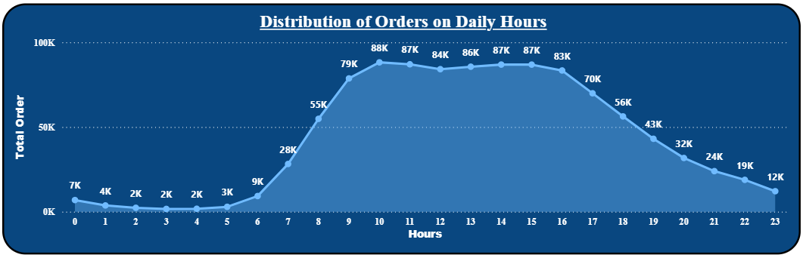
Distribution Orders per Daily Hours
INSIGHTS
Order volume is very low during midnight to early morning (12 AM–6 AM), with fewer than 10K orders per hour.
Orders increase rapidly from 7 AM onwards, reaching 55K by 8 AM and 79K by 9 AM.
10 AM records the highest order volume (88K), making it the peak ordering hour.
Order activity remains consistently high between 10 AM and 4 PM, with volumes ranging from 83K to 88K, indicating sustained customer demand throughout the day.
After 5 PM, order volume gradually declines, with a significant drop during the late evening hours.
Staffing, inventory availability, and delivery resources should be optimized during the 10 AM–4 PM peak period, while promotional offers can be used during off-peak hours to improve demand.

Slide 20
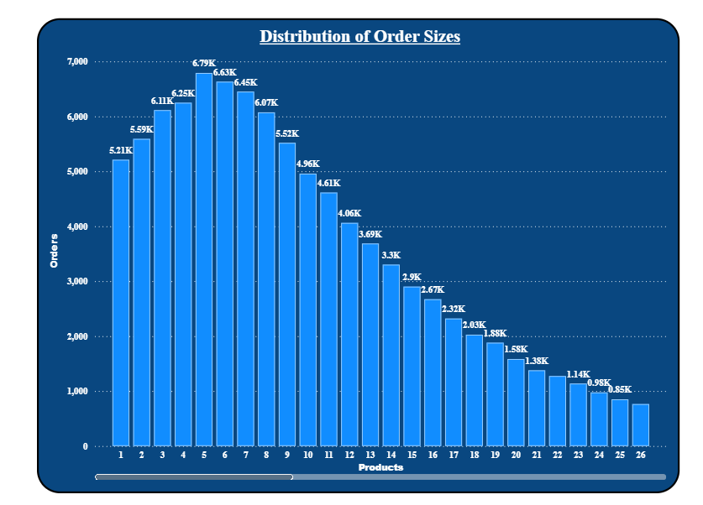
Distribution of Order size by Products
INSIGHTS
Orders containing 5 products are the most common, with approximately 6.79K orders.
Most customer orders contain 4–8 products, indicating a preference for medium-sized shopping baskets.
After 8 products, the number of orders gradually declines, showing fewer customers place very large orders.
Orders with 20 or more products are relatively uncommon, representing a small share of total transactions.
The distribution suggests customers typically purchase a moderate number of items rather than making very small or very large orders.
Product bundling and personalized recommendations can encourage customers to increase their basket size.

Slide 21
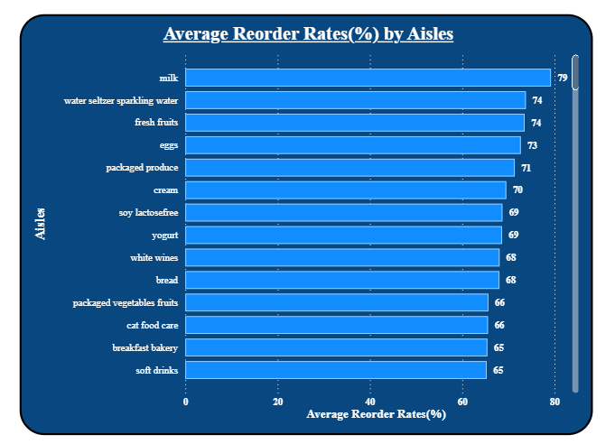
Distribution of Average Reorder Rate(%) by Aisle
INSIGHTS
Milk has the highest average reorder rate at 79%, indicating the strongest customer loyalty.
Water/Seltzer/Sparkling Water and Fresh Fruits follow closely with 74%, reflecting consistent repeat demand.
Essential grocery aisles such as Eggs (73%), Packaged Produce (71%), and Cream (70%) also have high reorder rates.
Most top-performing aisles have reorder rates between 65% and 79%, showing strong repeat purchasing across daily household essentials.
These aisles should be prioritized for inventory management and promotional strategies to maintain customer satisfaction.
The high reorder rates indicate that essential food categories drive repeat business.

Slide 22
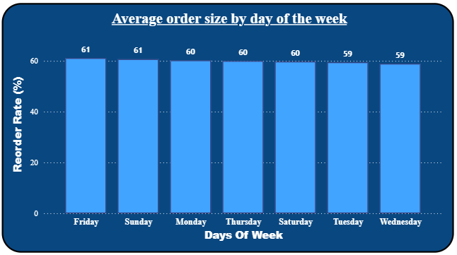
Distribution of Average Order Size(%) by Days of the Week
INSIGHTS
Friday and Sunday have the highest average order size (61 items), indicating customers purchase more products on these days.
Monday, Thursday, and Saturday follow closely with an average order size of 60 items.
Tuesday and Wednesday record the lowest average order size at 59 items, although the difference is minimal.
The variation in average order size across the week is very small (59–61 items), suggesting consistent purchasing behavior regardless of the day.
Slightly larger baskets on Friday and Sunday may reflect weekend grocery shopping patterns.
Marketing campaigns on midweek days could encourage customers to increase their basket size further.

Slide 23
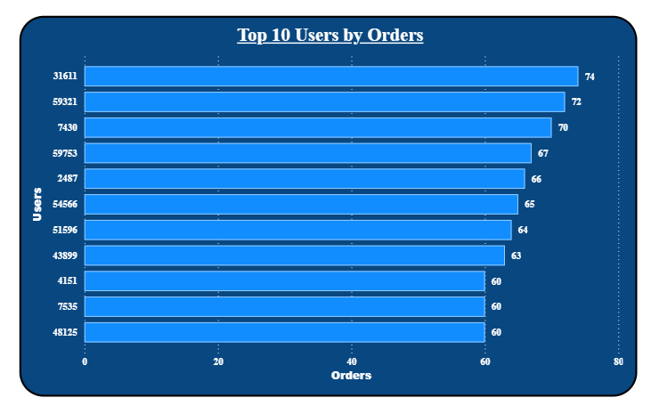
Distribution of Users by number of Order
INSIGHTS
The highest purchasing customer (User 31611) placed 74 orders, making them the most active customer.
The top 10 customers placed between 60 and 74 orders, showing consistently high purchasing activity.
The gap between the highest and lowest customer in the top 10 is relatively small (14 orders), indicating a balanced distribution among loyal customers.
These highly active customers represent valuable repeat buyers and should be targeted through loyalty programs, personalized offers, and exclusive rewards.
Understanding the purchasing behavior of these customers can help improve customer retention and maximize lifetime value.

Slide 24
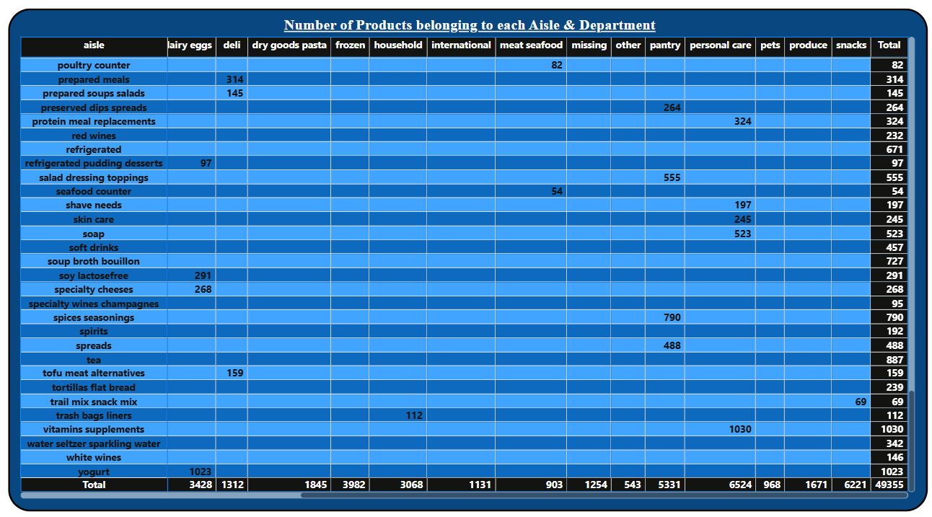
Products belonging to each Products & Department
INSIGHTS
The dataset contains 49,355 products distributed across multiple departments and aisles.
Personal Care has the product assortment (6,524 products), followed by Snacks (6,221) and Pantry (5,331).
Frozen (3,982) and Dairy & Eggs (3,428) also have a wide range of products, reflecting diverse customer choices.
Departments such as Meat & Seafood (903) and Other (543) contain comparatively fewer products.
At the aisle level, Vitamins & Supplements (1,030), Yogurt (1,023), Tea (887), Spices & Seasonings (790), and Soup Broth & Bouillon (727) have the highest number of products.
Product assortment information can help optimize inventory management, shelf allocation, and category planning by identifying departments with the largest and smallest product ranges.

Slide 25
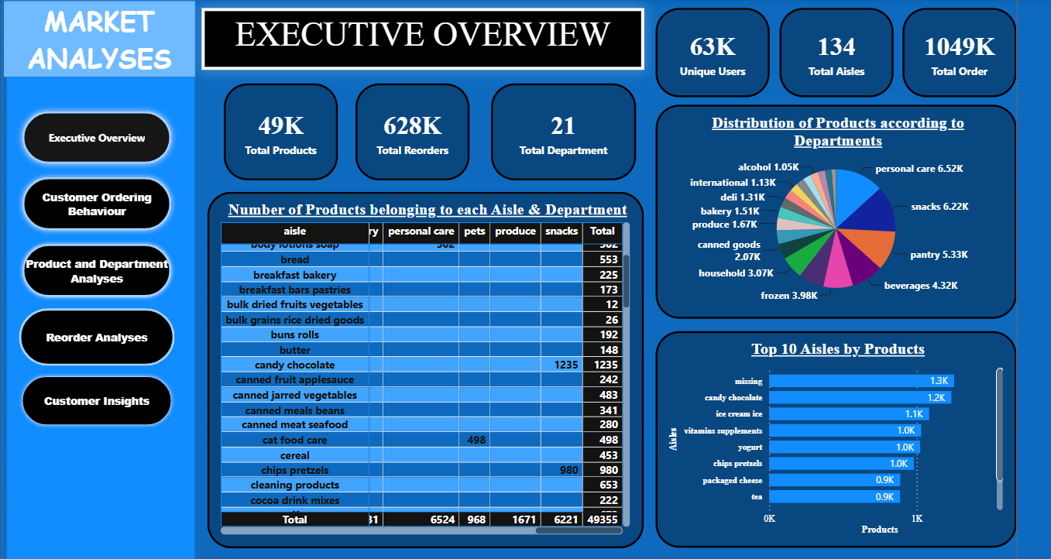
Executive Overview Dashboard

Slide 26
Executive Overview Dashboard(Insights)
INSIGHTS:
The business has a strong customer base of 63K unique users, who have placed 1.049 million orders, reflecting high customer engagement and consistent demand.
Out of the total orders, 628K are repeat orders, indicating strong customer loyalty and a high rate of repeat purchases.
The product catalog consists of 49K products spread across 21 departments and 134 aisles, offering customers a wide variety of products.
Personal Care (6.52K products), Snacks (6.22K), and Pantry (5.33K) are the largest departments by product count, showing that these categories have the widest assortment.
The "Missing" aisle contains the highest number of products, suggesting that some products are not properly categorized and require data cleaning for more accurate reporting.
The extensive product range across major departments enables customers to complete most of their shopping in a single platform, supporting convenience and customer satisfaction.

Slide 27
Executive Overview Dashboard(Recommendation)
Recommendations:
Customer Strategy
Strengthen customer retention programs to encourage more repeat purchases from the existing 63K users.
Introduce personalized product recommendations based on previous purchase history.
Inventory Management
Maintain higher inventory levels in departments with the largest demand, such as:
Personal Care
Snacks
Pantry
Beverages
Frozen
Regularly monitor stock levels of high-demand products to prevent stock-outs.

Slide 28
Executive Overview Dashboard(Recommendation)
Category Management
Optimize shelf space and warehouse allocation for departments with the largest product assortments.
Review departments with smaller assortments to determine whether additional products could improve customer choice.
Data Quality
Investigate and resolve the "Missing" aisle category by assigning products to their correct aisles.
Improving data accuracy will lead to better reporting and more reliable business decisions.
Marketing Strategy
Promote products from high-performing departments through targeted campaigns.
Bundle complementary products (e.g., snacks with beverages or pantry items) to increase average order value.
Launch promotional campaigns for lower-performing departments to improve visibility and sales.

Slide 29
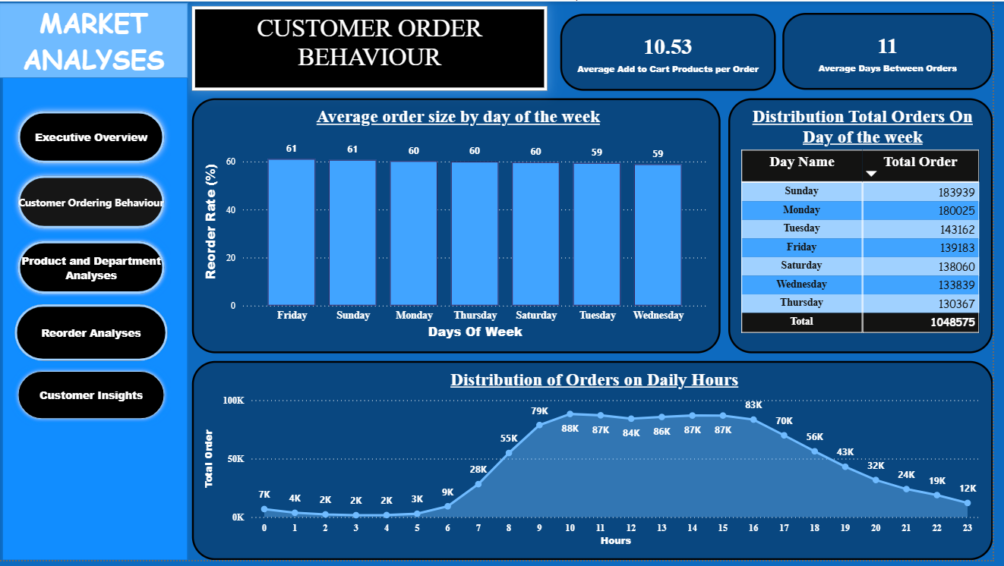
Customer Order Behavior Dashboard

Slide 30
Customer Order Behavior Dashboard(Insights)
INSIGHTS:
Customers order an average of 10.53 products per purchase.
The average gap between two orders is 11 days.
Sunday records the highest number of orders (183,939), while Thursday has the lowest (130,367).
Average order size remains consistent (59–61) across all days.
Order activity is highest between 9 AM and 4 PM, peaking around 4 PM.

Slide 31
Customer Order Behavior Dashboard(Recommendations)
Recommendations:
Optimize Inventory During Peak Demand
Increase inventory levels for products that experience high demand on Sundays, Mondays, and during peak shopping hours (9 AM–4 PM). Maintaining sufficient stock during these periods will reduce stock-outs, improve customer satisfaction, and minimize lost sales opportunities.
Increase Sales on Low-Demand Days
Introduce targeted promotions, discounts, or loyalty rewards on Tuesdays, Wednesdays, and Thursdays, when customer order volume is comparatively lower. Time-based offers can help distribute demand more evenly throughout the week.
Improve Operational Efficiency
Allocate more warehouse staff, delivery personnel, and customer support resources during peak ordering hours, while reducing staffing during late-night periods when order activity is minimal. This improves service quality and optimizes operational costs.

Slide 32
Customer Order Behavior Dashboard(Recommendations)
Strengthen Customer Retention
Since customers place orders approximately every 11 days, schedule personalized reminder emails, app notifications, or discount coupons around the 9th to 11th day after a customer's last purchase to encourage repeat orders.
Increase Average Basket Size
Implement cross-selling strategies such as "Frequently Bought Together", product bundles, and personalized recommendations during checkout. These techniques can encourage customers to add more items to their cart, increasing the average order value and overall revenue.

Slide 33
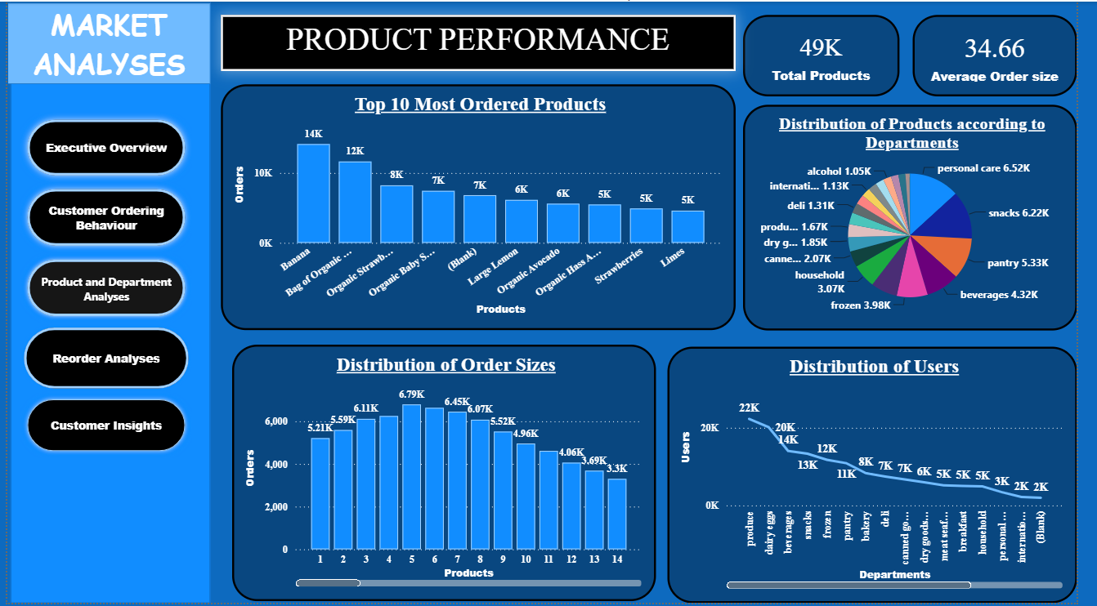
Product Performance Dashboard

Slide 34
Product Performance Dashboard(Insights)
INSIGHTS:
The dataset contains approximately 49K products with an average order size of 34.66.
Banana is the most ordered product, followed by Bag of Organic Bananas.
Personal Care, Snacks, and Pantry are the largest departments by product count.
Most customer orders contain 5–7 products, indicating moderate basket sizes.
The Produce department has the highest number of users, while departments like International and Personal Care have comparatively fewer users.

Slide 35
Product Performance Dashboard(Recommendations)
Recommendations:
Prioritize High-Demand Products
Ensure products such as Bananas, Organic Bananas, Organic Strawberries, and Organic Baby Spinach remain well-stocked. These products experience consistently high demand and should be prioritized in inventory planning to avoid stock shortages and improve customer satisfaction.
Optimize Product Assortment Across Departments
Departments such as Personal Care, Snacks, and Pantry contain the largest number of products. Regularly review product performance within these departments to remove slow-moving items and introduce new products that align with changing customer preferences.
Improve Cross-Selling Opportunities
Since most customers purchase 5–7 products per order, recommend complementary products during checkout through bundle offers and personalized suggestions. This can increase basket size and improve overall sales.

Slide 36
Product Performance Dashboard(Recommedations)
Strengthen Underperforming Departments
Departments with lower customer engagement should be supported through targeted promotions, improved product visibility, and category-specific marketing campaigns. Understanding customer preferences in these categories can help increase their sales contribution.
Focus Marketing on Popular Categories
Use the popularity of the Produce department to drive additional sales by promoting related products from other departments. Personalized recommendations and seasonal campaigns can encourage customers to explore more categories while maintaining strong engagement with high-performing products.

Slide 37
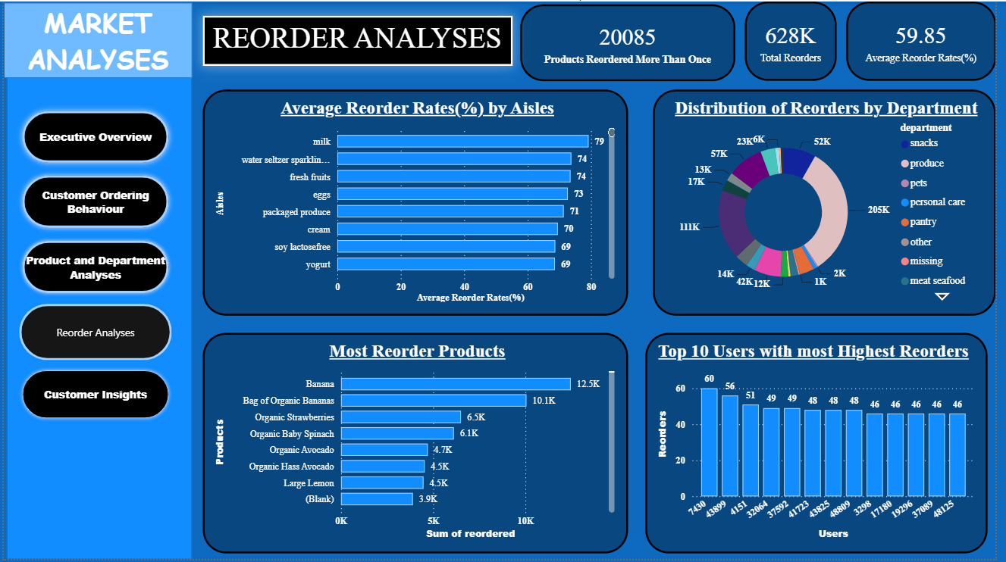
Reorder Analyses Dashboard

Slide 38
Reorder Analyses Dashboard(Insights)
INSIGHTS:
20,085 products have been reordered more than once, indicating strong customer loyalty for many products.
A total of 628K reorder transactions were recorded, with an overall average reorder rate of 59.85%.
Milk, Water Seltzer Sparkling, and Fresh Fruits have the highest reorder rates among aisles, all exceeding 70%.
Bananas and Bag of Organic Bananas are the most frequently reordered products, followed by Organic Strawberries and Organic Baby Spinach.
A small group of customers places the highest number of repeat orders, with the top user recording 60 reorders.

Slide 39
Reorder Analyses Dashboard(Recommendations)
Recommendations:
Maintain Stock for High-Reorder Products
Products such as Bananas, Bag of Organic Bananas, Organic Strawberries, and Organic Baby Spinach should receive priority in inventory planning. Their consistently high reorder frequency indicates stable customer demand, and preventing stock-outs will help maintain customer satisfaction and repeat sales.
Focus Marketing on High-Loyalty Categories
Aisles with high reorder rates, including Milk, Fresh Fruits, Eggs, and Yogurt, demonstrate strong customer loyalty. Personalized promotions, subscription options, and bundle offers for these categories can further strengthen repeat purchasing behavior.
Develop Customer Retention Programs
Since the overall reorder rate is 59.85%, introducing loyalty rewards, personalized coupons, and repeat-purchase incentives can encourage more first-time buyers to become repeat customers and further improve retention.

Slide 40
Reorder Analyses Dashboard(Recommendations)
Reward High-Value Customers
The top customers consistently place a large number of repeat orders. Offering exclusive discounts, early access to promotions, or membership benefits can help retain these valuable customers and increase their lifetime value.
Improve Performance of Low-Reorder Categories
Departments and products with relatively lower reorder activity should be analyzed to identify possible issues such as pricing, product quality, availability, or customer preferences. Targeted promotional campaigns and improved product visibility can help increase repeat purchases in these categories.

Slide 41
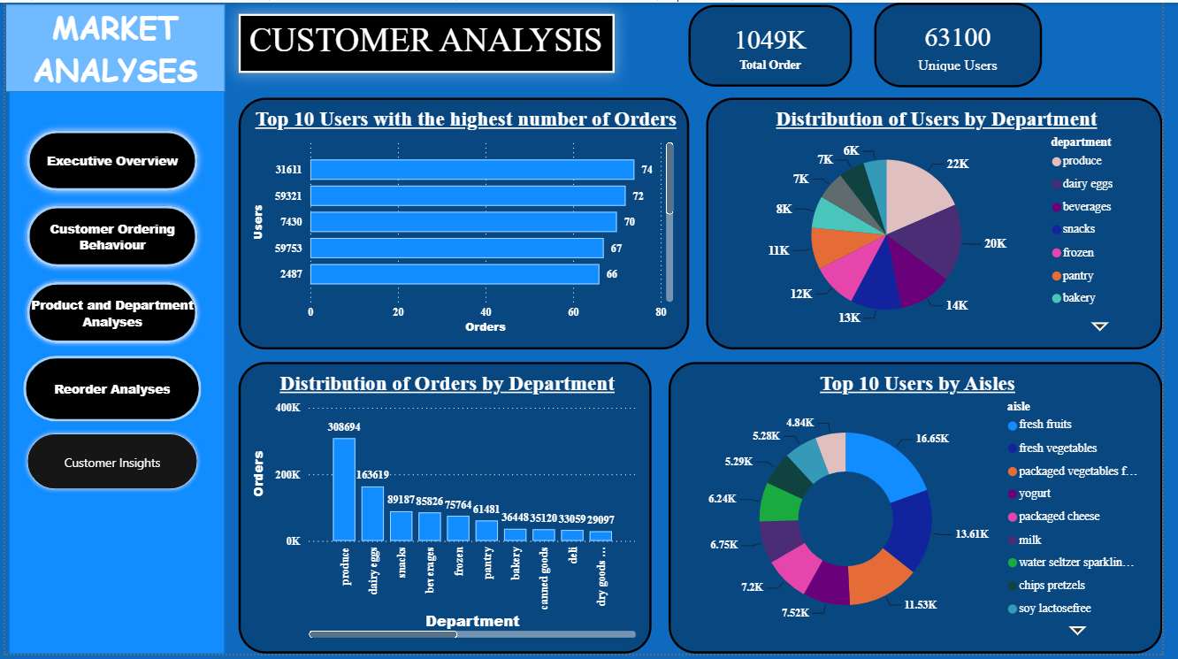
Customer Analyses Dashboard

Slide 42
Customer Analyses Dashboard(Insights)
INSIGHTS:
The dataset contains 1.049 million orders placed by 63,100 unique users.
A small group of customers places significantly more orders, with the top customer completing 74 orders.
The Produce department has the highest number of users and orders, making it the most popular department.
Fresh Fruits and Fresh Vegetables are the most preferred aisles among customers.
Order activity is concentrated in a few departments, while categories such as Deli and Dry Goods Pasta receive comparatively fewer orders.

Slide 43
Customer Analyses Dashboard(Recommendations)
Recommendations:
Strengthen Customer Loyalty Programs
The top customers contribute a significant number of orders, indicating strong customer loyalty. Introduce reward programs, exclusive discounts, and personalized offers to retain these high-value customers and encourage them to continue purchasing frequently.
Focus Inventory on High-Demand Departments
The Produce department consistently attracts the largest number of customers and orders. Maintaining adequate inventory levels and ensuring product availability in this department will help improve customer satisfaction and reduce missed sales opportunities.
Enhance Cross-Selling Across Popular Aisles
Since Fresh Fruits and Fresh Vegetables are the most visited aisles, recommend complementary products such as dairy items, beverages, and packaged foods during shopping or checkout. This can increase basket size and improve overall sales.

Slide 44
Customer Analyses Dashboard(recommendations)
Improve Performance of Low-Demand Categories
Departments with comparatively lower customer activity should be evaluated to identify possible reasons such as limited product variety, pricing, or visibility. Promotional campaigns, better product placement, and category-specific discounts can help improve their performance.
Personalize Marketing Based on Customer Behavior
Use customers' purchase history and department preferences to deliver targeted recommendations and personalized promotions. This approach can improve customer engagement, increase repeat purchases, and strengthen long-term customer relationships.

Slide 45
Key Findings
KEY FINDINGS:
The dataset contains 1.049 million orders placed by 63,100 unique users across 49K products, 134 aisles, and 21 departments.
Customers purchase an average of 10.53 products per order and place repeat orders approximately every 11 days.
Banana and Bag of Organic Bananas are the most ordered and most frequently reordered products.
Produce, Personal Care, Snacks, and Pantry are the highest-performing departments in terms of products, users, and orders.
Approximately 628K reorder transactions were recorded, with an average reorder rate of 59.85%, indicating strong customer loyalty.

Slide 46
Challenges Faced
Merged multiple datasets using primary and foreign keys while maintaining correct relationships.
Created DAX measures for KPIs such as average order size, reorder rate, average days between orders, and products per order.
Designed an interactive Power BI dashboard with slicers, navigation buttons, and consistent formatting.
Resolved issues related to incorrect relationships, filter context, and DAX calculations during dashboard development.
The provided database did not include the order_products_prior table mentioned in the project description, limiting the calculation of true product-level reorder rates.

Slide 47
CONCLUSION
The Market Analysis Dashboard successfully transformed raw transactional data into meaningful business insights by analyzing customer purchasing behavior, product performance, and reorder patterns. The analysis identified high-demand products, popular departments, peak shopping periods, and customer buying habits, providing a comprehensive understanding of overall business performance.
The dashboard enables stakeholders to monitor key performance indicators, optimize inventory management, improve marketing strategies, and strengthen customer retention through data-driven decision-making. Despite the limitation of the missing order_products_prior dataset mentioned in the project description, the available data provided valuable insights into customer behavior and product trends.
Overall, this project demonstrates how MySQL, Power BI, Power query and DAX can be effectively used to convert large volumes of transactional data into interactive dashboards that support strategic business decisions, improve operational efficiency, and enhance customer satisfaction.

